Slide 1

Department of Computer Engineering
Logic gates and Boolean algebra rules
1

Slide 2
Points
Department of Computer Engineering
Logic Gates
Boolean algebra theorems
Examples
Proof of theorem
De Morgan’s theorems

Slide 3
Departmental Vision & Mission
Department of Computer Engineering
Vision
Achieve academic excellence through education in computing, to create intellectual manpower to explore professional, higher educational and social opportunities.
Mission
To impart learning by educating students with conceptual knowledge and hands on practices using modern tools, FOSS technologies and competency skills there by igniting the young minds for innovative thinking, professional expertise and research.
3

Slide 4
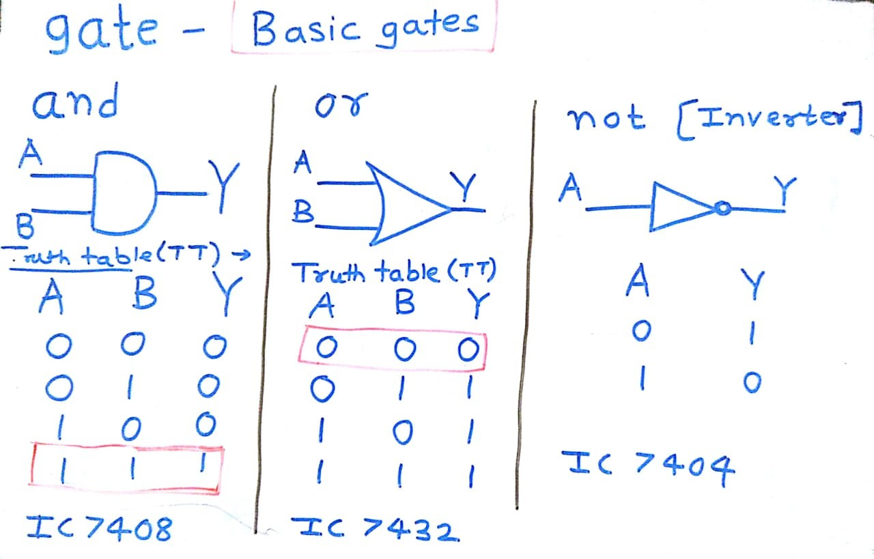



Logic Gates
Department of Computer Engineering
Basic gates – and, or , not

Slide 5
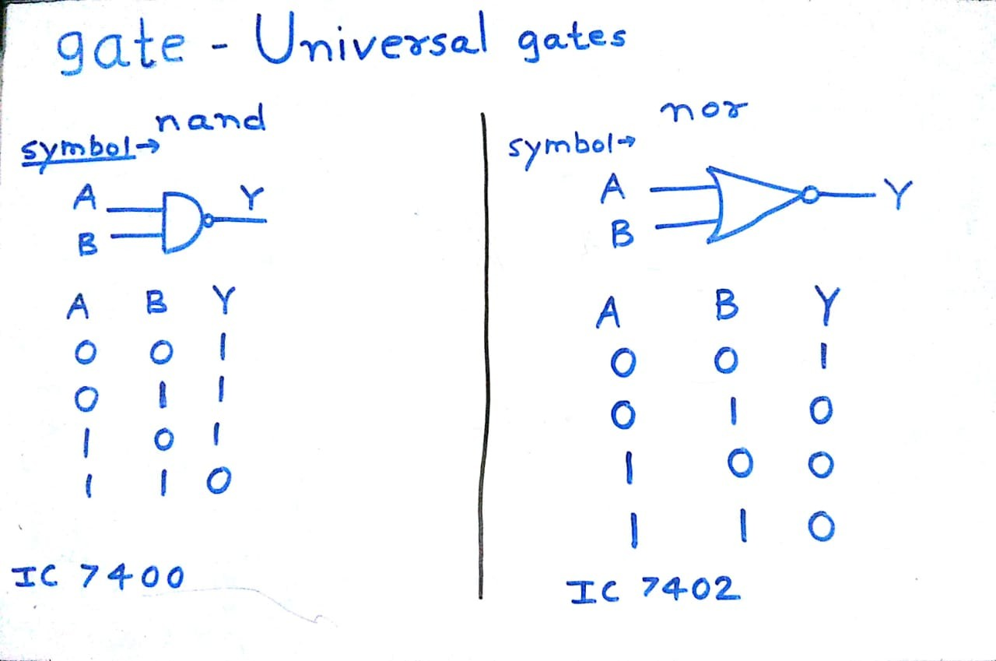

Department of Computer Engineering
Universal gates-

Slide 6
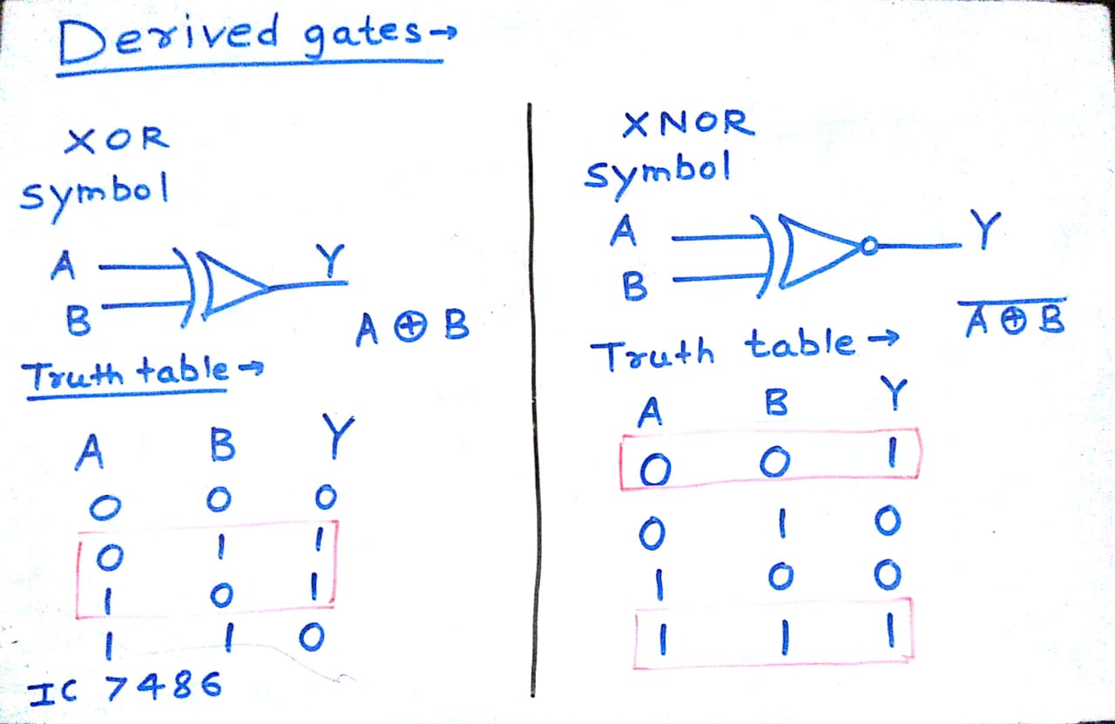


Department of Computer Engineering
Derived gates -

Slide 7
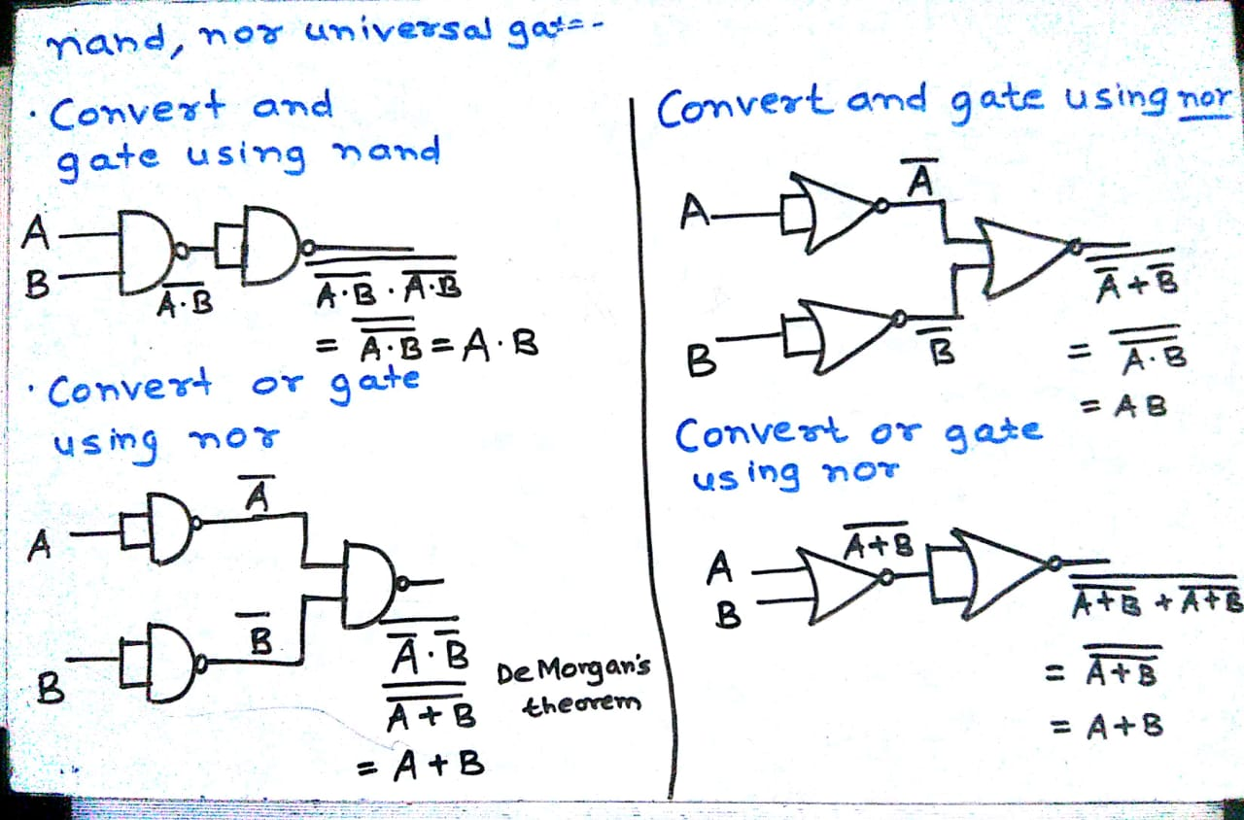
Exercise
Department of Computer Engineering
NAND

Slide 8

Boolean algebra theorems
Department of Computer Engineering
Theorem No. | Theorem
1 | A + 0 = A
2 | A . 1 = A
3 | A + 1= 1
4 | A . 0 = 0
5 | A + A = A
6 | A . A= A
7
8
9 (Distributive) | A. (B + C) =AB + AC
10 (Distributive) | A + BC = (A + B) (A+C)
11 | A + AB = A
Theorems are set of rules used to simplify given logic expression.
Theorems 1.1 to 1.8 involve a single variable only.
or rules – Theorem 1,3,5,7
and rules – Theorem 2,4,6,8
Each of these theorems can be proved by considering every possible value of the variable.
For example, in Theorem 1.1,
if A = 0 then 0 + 0 = 0 = A and
if A = 1 then 1 + 0 = 1 = A

Slide 9
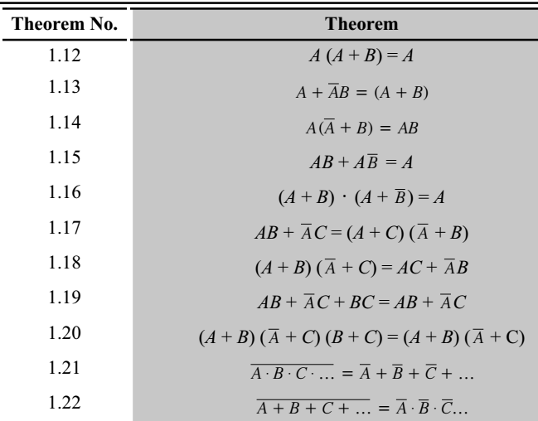

Boolean algebra theorems
Department of Computer Engineering
Theorems 1.9 to 1.20 involve more than one variable and can be proved by making a truth table.
A digital circuit using the gates
can be designed to realize a logic equation.
It is possible to simplify (minimize) a logic equation.
The minimized logic equation will probably need less number of gates and/or less number of inputs for the gates.

Slide 10
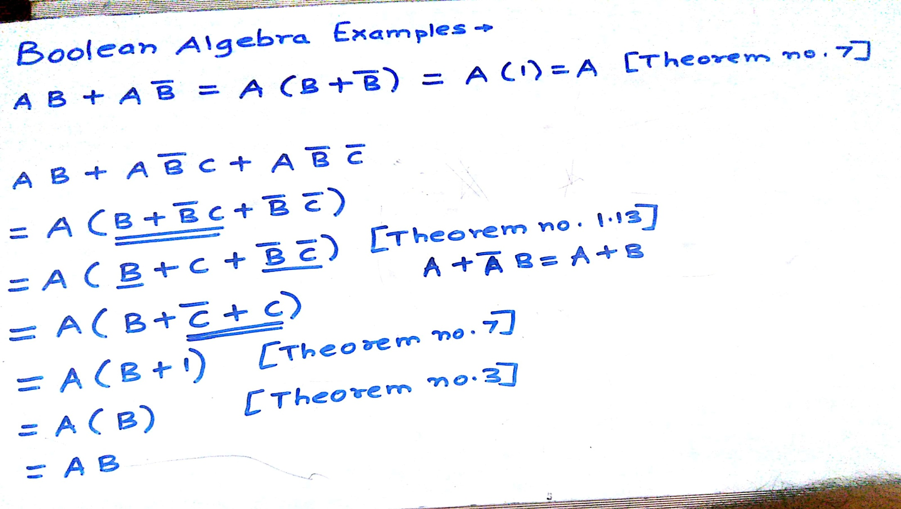



Examples

Slide 11
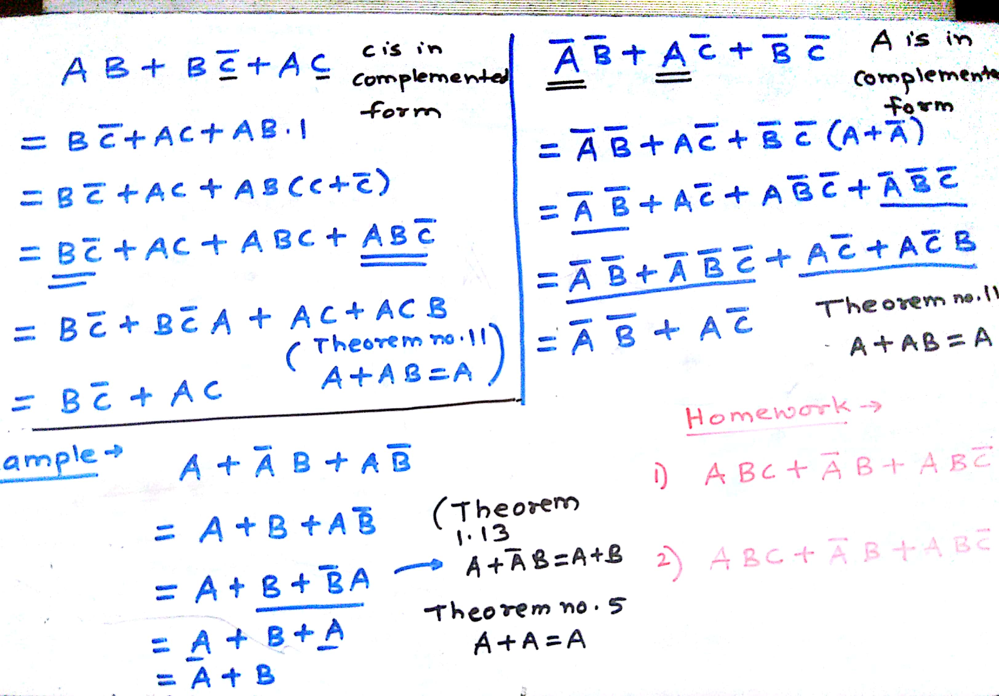
Examples

Slide 12



Proof of theorem 1.9 A. (B + C) =AB + AC
Department of Computer Engineering
A | B | C | B +C | A(B+C) | AB | AC | AB + AC
0 | 0 | 0 | 0 | 0 | 0 | 0 | 0
0 | 0 | 1 | 1 | 0 | 0 | 0 | 0
0 | 1 | 0 | 1 | 0 | 0 | 0 | 0
0 | 1 | 1 | 1 | 0 | 0 | 0 | 0
1 | 0 | 0 | 0 | 0 | 0 | 0 | 0
1 | 0 | 1 | 1 | 1 | 0 | 1 | 1
1 | 1 | 0 | 1 | 1 | 1 | 0 | 1
1 | 1 | 1 | 1 | 1 | 1 | 1 | 1

Slide 13
Proof of theorem 1.10 A + BC = (A + B) (A+C)
Department of Computer Engineering
A | B | C | BC | A+BC | A+B | A+C | (A+B). (A+C)
0 | 0 | 0 | 0 | 0 | 0 | 0 | 0
0 | 0 | 1 | 0 | 0 | 0 | 1 | 0
0 | 1 | 0 | 0 | 0 | 1 | 0 | 0
0 | 1 | 1 | 1 | 1 | 1 | 1 | 1
1 | 0 | 0 | 0 | 1 | 1 | 1 | 1
1 | 0 | 1 | 0 | 1 | 1 | 1 | 1
1 | 1 | 0 | 0 | 1 | 1 | 1 | 1
1 | 1 | 1 | 1 | 1 | 1 | 1 | 1

Slide 14





De Morgan’s theorems
Department of Computer Engineering
A | B | A.B
0 | 0 | 0 | 1 | 1 | 1 | 1 | 1 | 1
0 | 1 | 0 | 1 | 1 | 0 | 1 | 0 | 0
1 | 0 | 0 | 1 | 0 | 1 | 1 | 0 | 0
1 | 1 | 1 | 0 | 0 | 0 | 0 | 0 | 0

Slide 15
Summary
Department of Computer Engineering
Logic Gates
Boolean algebra theorems
Examples
Proof of theorem
De Morgan’s theorems

Slide 16
Department of Computer Engineering
Thank you

